Slide 1

Group – 5 1.Asuthosh 2.Samvadana 3.Udhayasri 4.Prasanna 5.Yuvraj

Slide 2
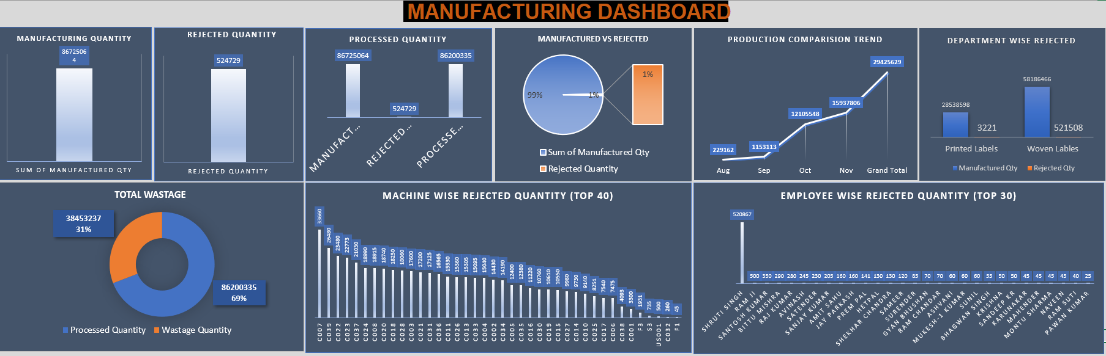
Excel Dashboard

Slide 3
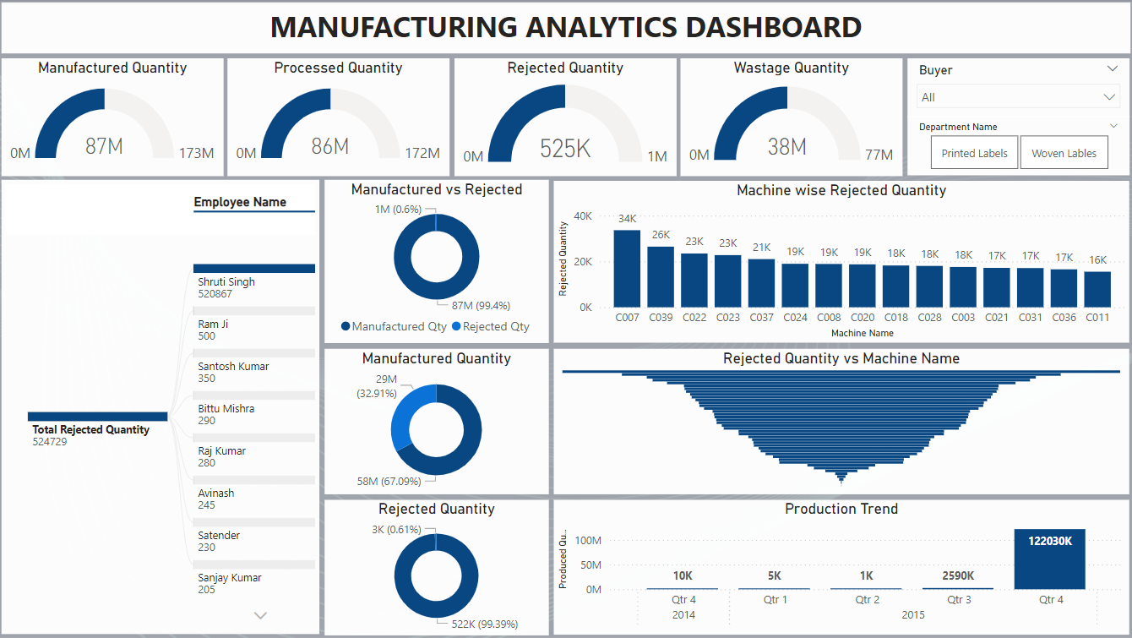
PowerBi Dashboard

Slide 4
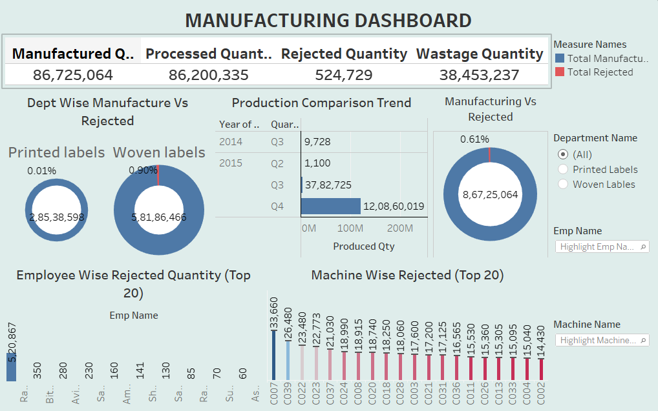
Tableau Dashboard

